Slide 1
2022 Fall Network Challenges
September 13, 2022
John Pritchard
Director of Technology
Sioux City Community School District
Notes:
This title slide is for District presentations only. Building staff should select their respective title slide and remove the others, including this slide.

Slide 2
Overview
During the Summer of 2022 the Technology Department had the following network projects:
Replaced 1,300 Access Points around the District
Replaced Smoothwall with Linewize content filtering
Replaced part of WebManager (some of the dependency on Ted custom code)
The Pros
Meraki MR32 (1.2Gbps) to Aruba AP-515 (2.69Gbps)
Linewize integrated with the login of the device (no Ted code, do not have to remind students to log into Smoothwall)
While I am proud of the accomplishments, we know there are issues that need to be addressed

Slide 3
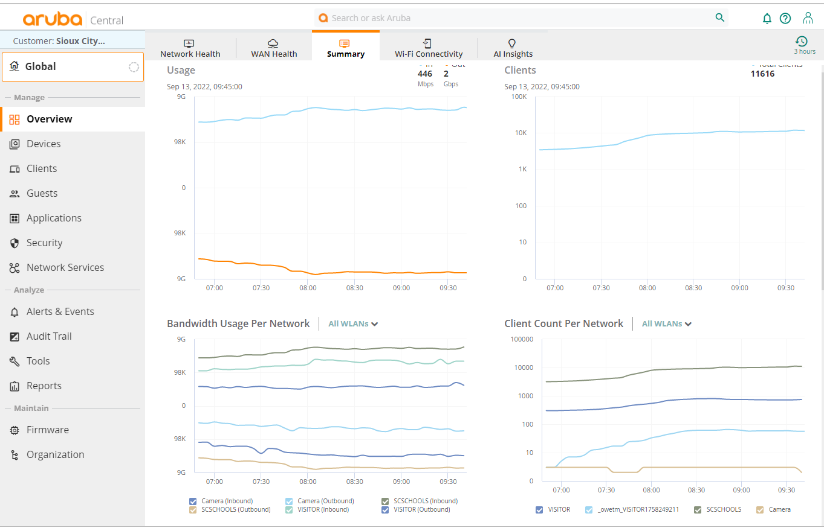
Tools

Slide 4
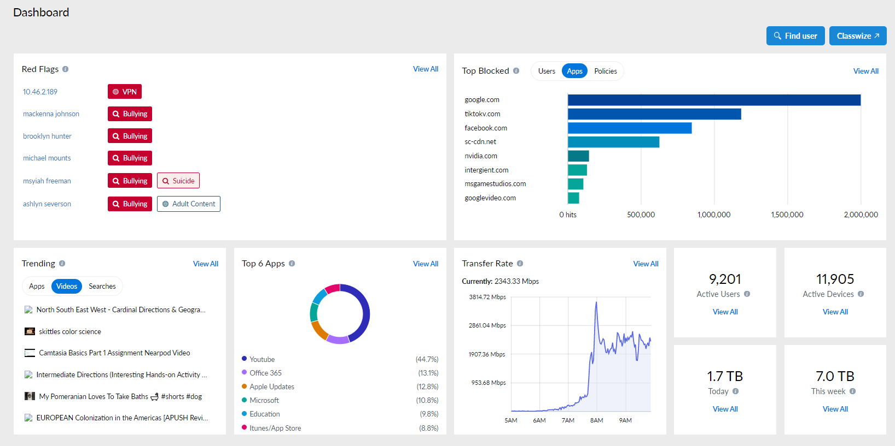
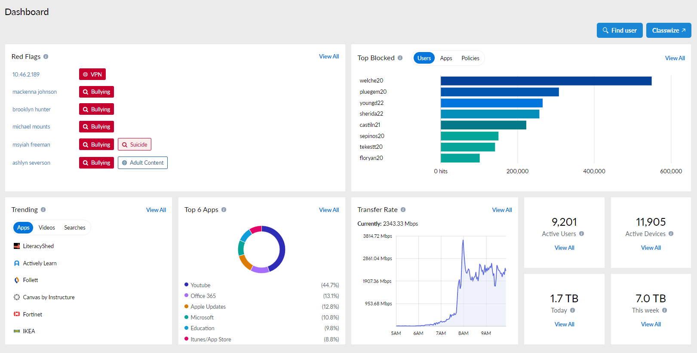
Tools

Slide 5
Internet/Linewize/Network Tickets
263 Tickets since July 1, 2022 – 7.5% of the 3,553 total tickets
14 are still open
8 are waiting on customer
North High 30
Education Service Center 27
West High 24
Bryant 20
Career Academy 20
East High 19
West Middle 14
V.I.B.E Academy 13
East Middle 12
Spalding Park 11
Loess Hills 10
Other 9
Perry Creek 8
North Middle 7
Irving 7
Harry Hopkins 5
Morningside 5
Unity 4
Liberty 4
Hunt 3
Leeds 3
Boy's & Girl's Home 2
Private Residence 2
Nodland 1
Riverside 1
Sunnyside 1
Alternative School 1

Slide 6
What all needs to work?
Your device
The operating system needs to be up to date
The device drivers need to be up to date
The Linewize Authentication Client and logged in
The Linewize Connect Client must be operating (this has basic filtering)
Your device needs to connect to the wireless
Needs to find an Access Point (if you move, it can get confused, so disconnecting and connecting might help)
and connect to it (your device must authenticate for security)
The Access Point must be connected to the building network
The building network must be connected to the District Wide Area Network (WAN) – a fiber optic ring that runs around the city
The Linewize ‘appliance’ must be operational
The firewall must be operational
Fibercomm’s Internet connection must be operational
Next stop – the Linewize Cloud must check the web site
Finally, the web site you are going to must be operational and responding correctly

Slide 7
What all needs to work?
Your device
The operating system needs to be up to date
The device drivers need to be up to date
The Linewize Authentication Client and logged in
The Linewize Connect Client must be operating (this has basic filtering)
Your device needs to connect to the wireless
Needs to find an Access Point (if you move, it can get confused, so disconnecting and connecting might help)
and connect to it (your device must authenticate for security)
The Access Point must be connected to the building network
The building network must be connected to the District Wide Area Network (WAN) – a fiber optic ring that runs around the city
The Linewize ‘appliance’ must be operational
The firewall must be operational
Fibercomm’s Internet connection must be operational
Next stop – the Linewize Cloud must check the web site
Finally, the web site you are going to must be operational and responding correctly

Slide 8
Where have our challenges been?
Getting updates installed on the devices
Linewize issues:
Their Authentication Server ran out of gas in the first week of school
Linewize had a bug where they were not able to determine what group a user was in
We are currently having trouble with their cloud-based Verdict services (determining whether the site is appropriate or not)
This causes filtering to go to the CIPA default (required by law to filter)
Wireless Issues
Tuning of the wireless access points – getting the radio waves to work together and not against each other
Updating wireless drivers on laptops so they better communicate with access points
Cloud-based Applications
We have experienced some services (Lexia, SeeSaw, NearPod) having ‘start of the school year’ issues
New Curriculum Content and New Assessment Systems
Setting up the new authentication and class rostering

Slide 9
What can you try?
Restart (not shutdown and start) your device every day or two
Turn off and on your wireless services
If you have a lot of tabs open, close the browser and open back up… and close tabs
Try other sites to see if it is a particular site issue
Try another browser
Clear your browser cache
Chrome https://sccsd.freshdesk.com/a/solutions/articles/11000115234?portalId=1000013317
Firefox https://sccsd.freshdesk.com/a/solutions/articles/11000114863?portalId=1000013317
Perform Windows Updates and Check Microsoft
https://sccsd.freshdesk.com/a/solutions/articles/11000094989?portalId=1000013317

Slide 10
If all else fails – enter a ticket
Enter a ticket - Include the following in the ticket:
What were you doing that was not working well? (browsing, what site?)
What browser were you using?
Provide a snapshot of the issue
What time where you doing this?
Where specifically were you (room number)?
Were you plugged in or wireless?
Was anyone in the room experiencing the same problem? Was anyone in the room operating correctly?

Slide 11
Questions?

