Slide 1
Creating a PDF of the IEP

Slide 2
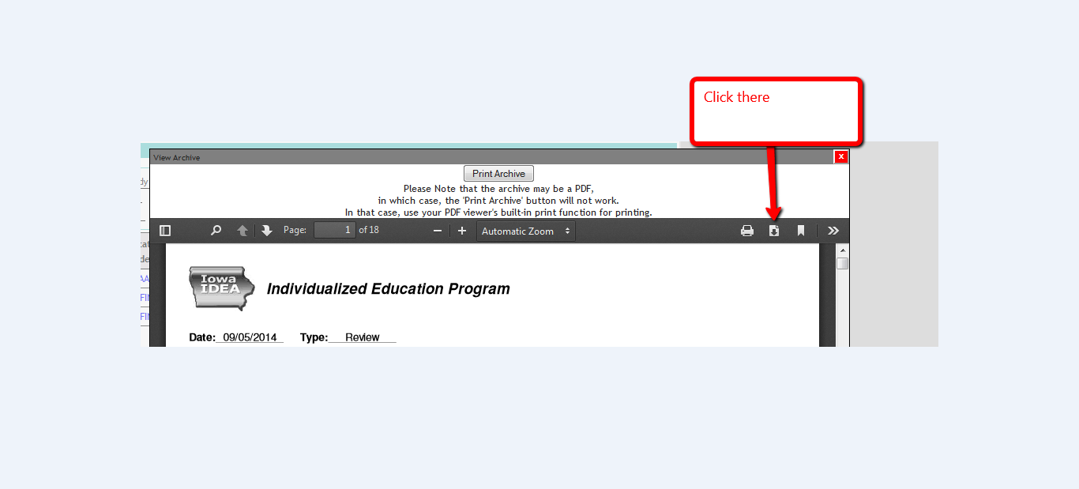

Slide 3
Creating a PDF of the IEP

