Slide 1
New Teacher Orientation
Technology by Level
Elementary and Preschool
Matt Pointer
Information Systems Administrator (Infinite Campus Grade Book Guy)
Sioux City Community School District
Notes:
This title slide is for District presentations only. Building staff should select their respective title slide and remove the others, including this slide.

Slide 2
New Teacher Orientation Infinite Campus Summary
How to get to Infinite Campus Grade Book
Navigation between the 2 side of Infinite Campus (IC)
Attendance
Add a new Assignment or Assessment
Contact information for students
Roster - Flags
Message Center - Email students/parents
Parent/Student Portals
Reports i.e. Report Cards
Assessment Area – Gold, Fast, ISASP
Next Clever with Ashley Wheat

Slide 3
Infinite Campus Warning
This is a functional presentation not a policy presentation.
Different buildings have different needs thus they have different guidance.
I am Happy to help with software functionality.

Slide 4
Resources for Help
Ask another teacher that is your same grade level (PLC)
Ask your Consultant Teacher (CT)
Put in a Help Desk Ticket by going on the link below or by clicking the icon on your desktop.
https://sccsd.freshdesk.com

Slide 5
Common Issues
If you can’t login to the machine or IC:
Solution: Create a ticket.
If you can’t see your building:
Solution: 1) Make sure HR has you marked for that building.
2) Create a ticket for Matt Pointer
If you are missing a class:
Solution: Contact your registrar so they can assign you the class(s).
Note: Help Desk Ticket → https://sccsd.freshdesk.com

Slide 6
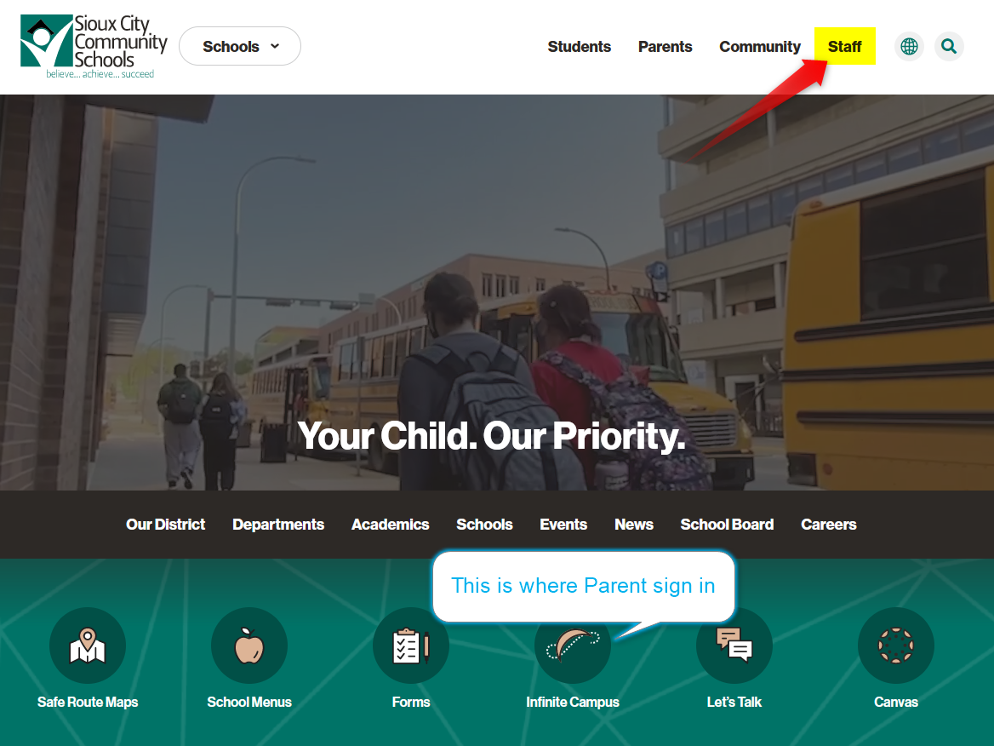
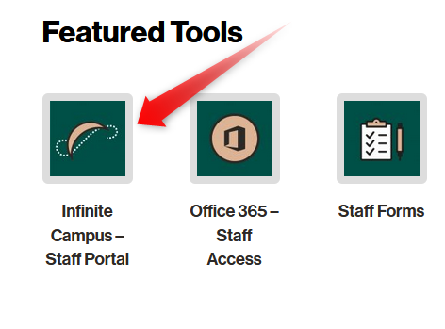
How to get to Infinite Campus Grade Book
Bullet Points - Title Here
Open your Firefox browser
Go to https://www.siouxcityschools.org
Click Staff
Click on Infinite Campus-Staff Portal

Slide 7
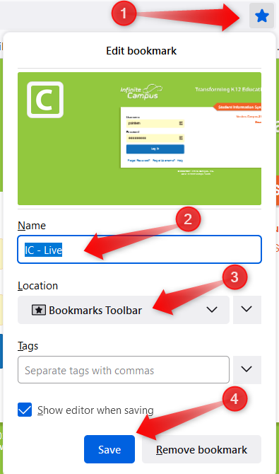
Second way to Infinite Campus Grade Book
Bullet Points - Title Here
Open your Firefox browser
Go to https://campus.siouxcityschools.org/campus/siouxcity.jsp
Save as a Favorite (Bookmark menu or tool bar) see left picture

Slide 8
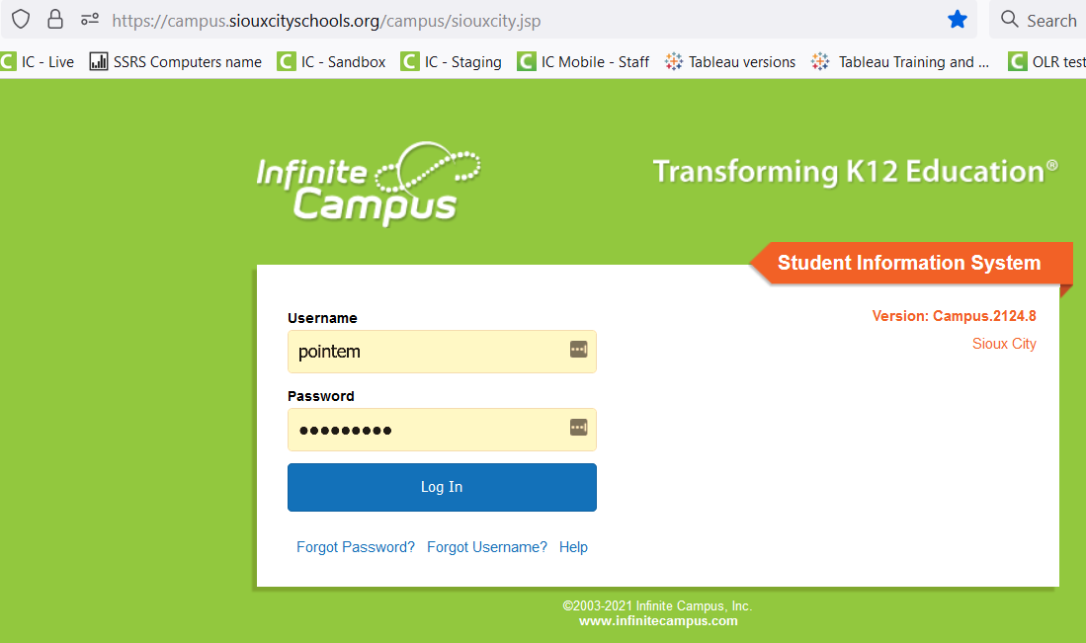
Log in to Infinite Campus
Bullet Points - Title Here
Once you see this screen then Login.
Username and password are the same as what you logged into the computer.
Not your email address

Slide 9
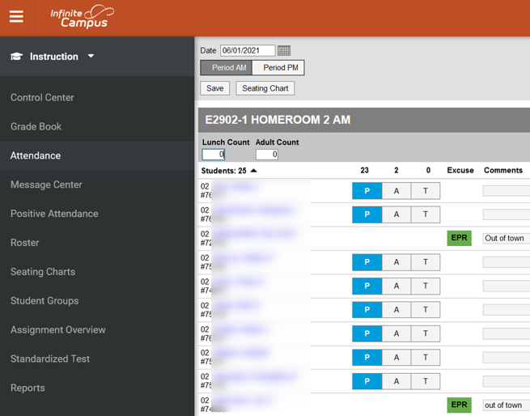
Two sides – Instruction vs. Campus Tools

Slide 10
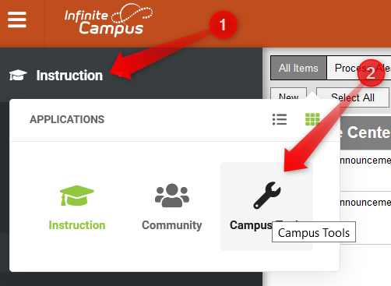
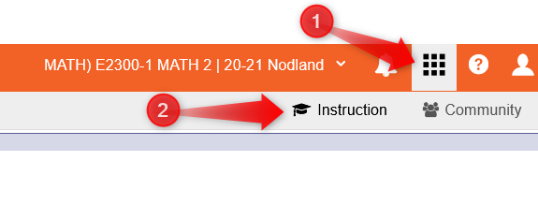
Two sides – Instruction vs. Campus Tools

Slide 11
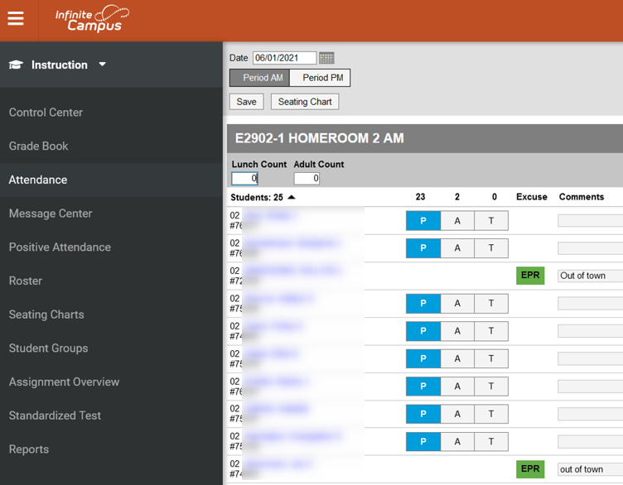
In Instruction
Click Attendance
Taking Attendance TODAY ONLY
Click the period.
Enter the Lunch Count
Enter Adult Count
Attendance defaults to present, so if everyone is present then click save.
Otherwise click A for Absent or T for Tardy
Optional: Enter a comment for A or T
Click SAVE
Attendance thru Control Center or Seating Charts are not covered in this session.
Attendance
Bullet Points - Title Here

Slide 12
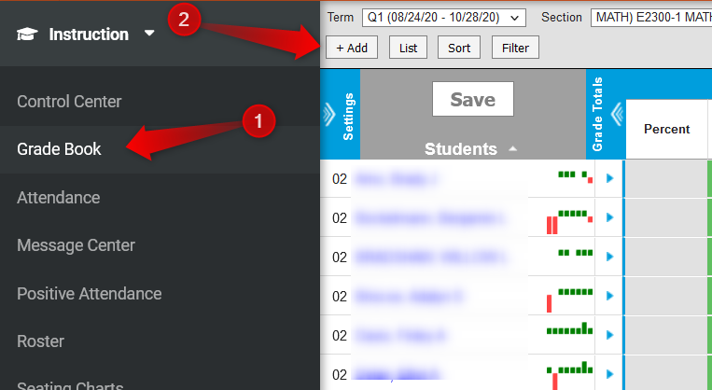
How to Add a New Assignment/Assessment
Bullet Points - Title Here
Navigate to Instruction side
Click Grade Book
Select the Term – Q1, Q2, Q3, Q4
Section = Subject i.e. Math, Reading
Task = Standards (standards look similar)
Click the ADD button
Option

Slide 13
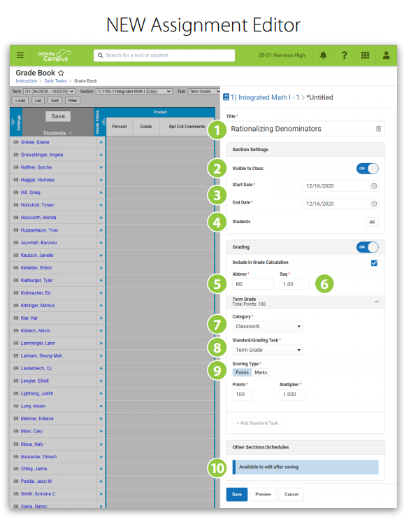
Add Assignment/Assessment
Bulle Points - Title Here
Type Title for the Assignment/Assessment
Dates are they in the correct quarter?
Abbreviation is auto populated, you are welcome to change it
Category – Formative or Summative
Formative = practice
Summative = Assessment (Report Card Grade)
Standard defaults to the one you are in
Keep Scoring type on Rubric
SAVE!!
After saving you can add sections
Option

Slide 14
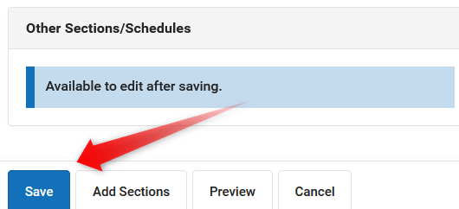
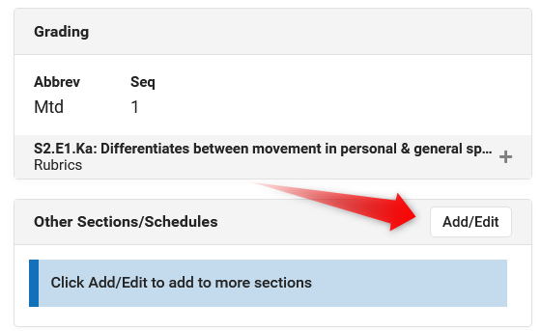
Add Sections to Assignment/Assessment
Bllasdfsadfkj;
Adding more sections to the Assignment can save you some time.
If you are a teachers with multiple sections of the same subject for example Art, Music, or PE. Or I have 2 math sections.
Once you click Save on the assignment, the Add/edit button will appear so you can add sections, but not before you click save.
Click Add/Edit
If you have 3 sections of 1st grade PE then you can add the other 2 sections to the current one you are in. Thus entering one assignment rather then 3.
Option

Slide 15
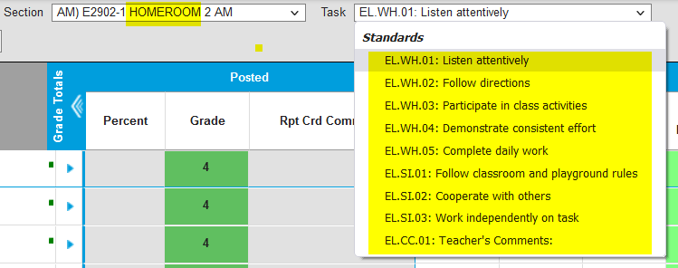
Standards Misc. Information
Bllasdfsadfkj;
Speaking and Listening Standard(s) are under the Reading subject.
Behavior and Work Habits are under the Homeroom AM section
NOTE: some standards are similar in wording, so double check that you are in the correct standard for that quarter. Pacing Guide will help.
Grading scale is 1-6 (6 is highest)
1-3 Not Proficient
4-6 Proficient
Option

Slide 16
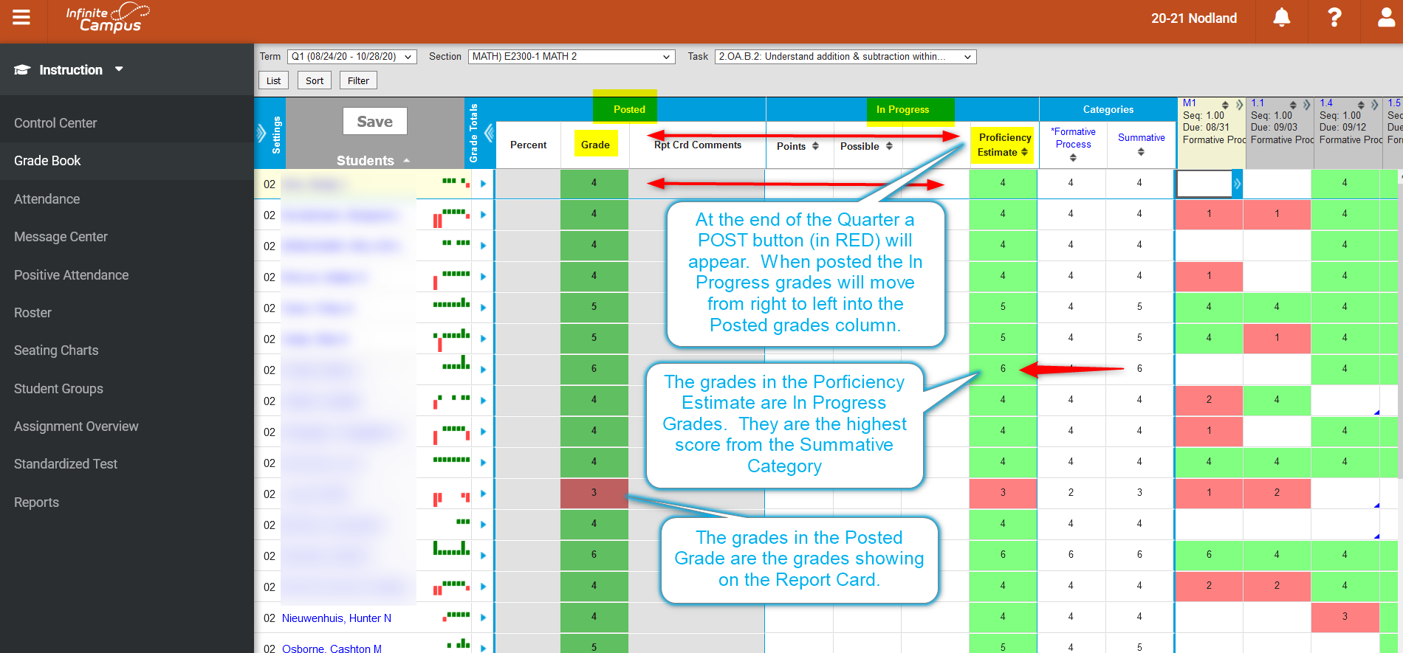
Sample IC Grade Book

Slide 17
Sample IC Grade Book

Slide 18
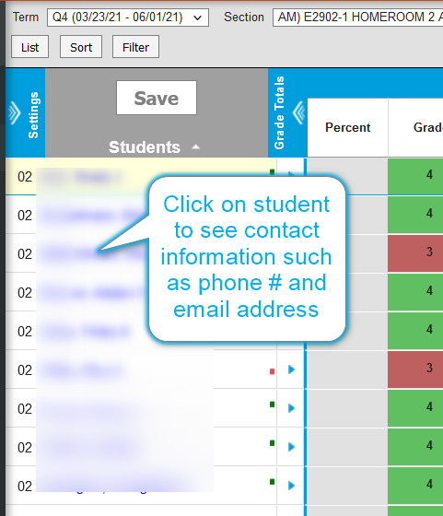
Contact information for a student

Slide 19
Roster Information

Slide 20
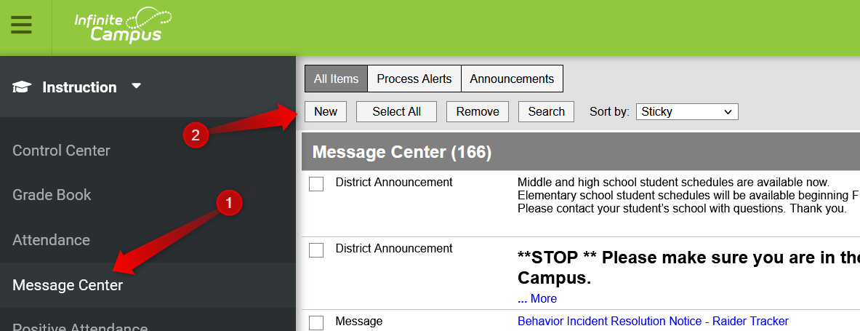
Message Center - Email
Message Center has notifications for you
To email a student or Parents
Click Message Center
Click New

Slide 21
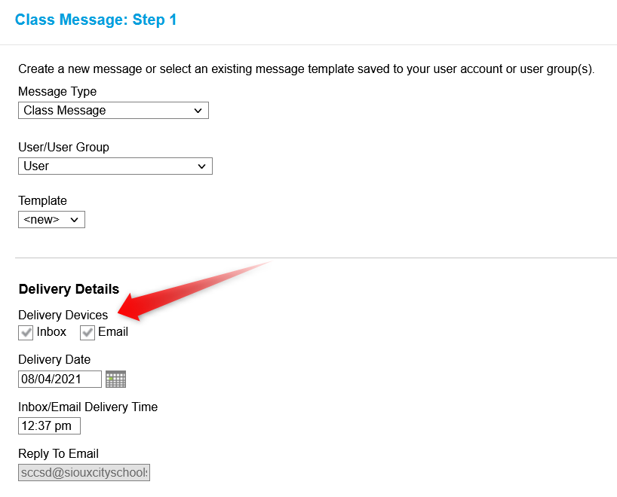
Message Center - Email
Message type should be Class Message
Choose the Delivery Devices you can do just one or both
Email will send to the student/parent email address
Inbox will send to the portal for the student or parent

Slide 22
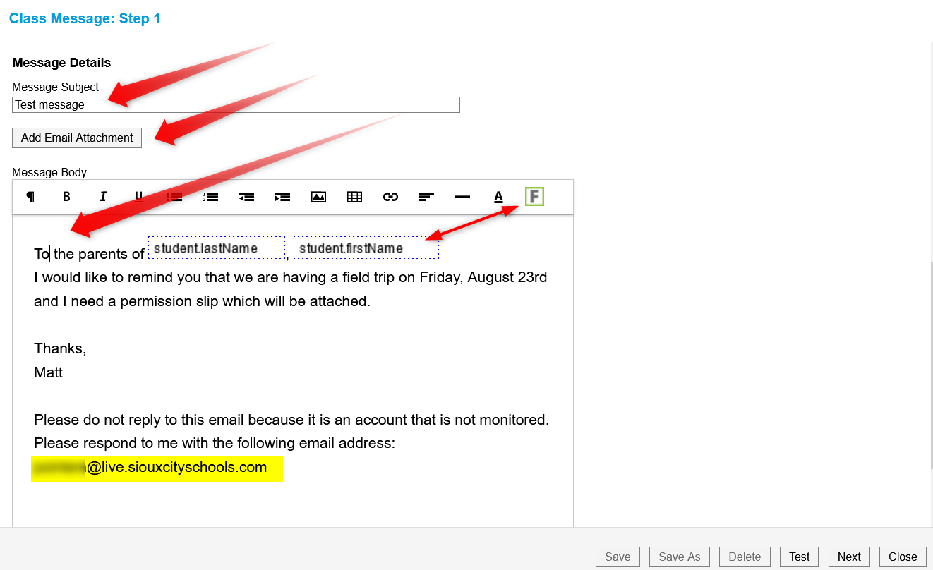
Message Center - Email
Type a subject line
You can add an attachment
Type the body of the message
The green “F” can be used to create a form letter
This email address is not monitored, so include a line with your email address so the parents can reply back to you.
Click TEST and enter your email address to see what the email message looks like.
Click NEXT

Slide 23
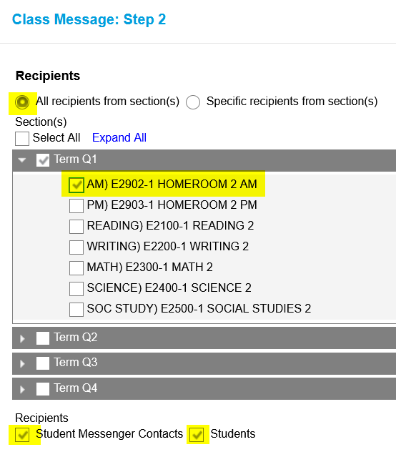
Message Center – Email to Whole Class/Parents
Do you want to mass mail or just specific people?
All recipients from section – means you want all people related to the class.
Select the Homeroom and you should get everyone.
Do you want students or Parents or both
Click NEXT

Slide 24
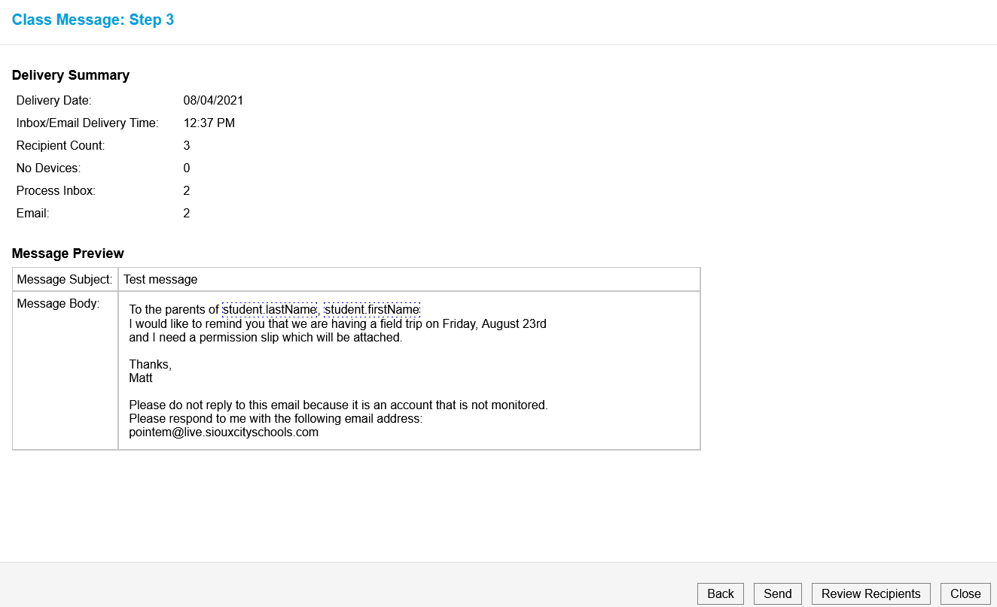
Message Center – Email to Whole Class/Parents
Here is the message being sent and to whom it is sent.
You can review the recipients in detail by clicking the Review Recipients button.
Click SEND

Slide 25
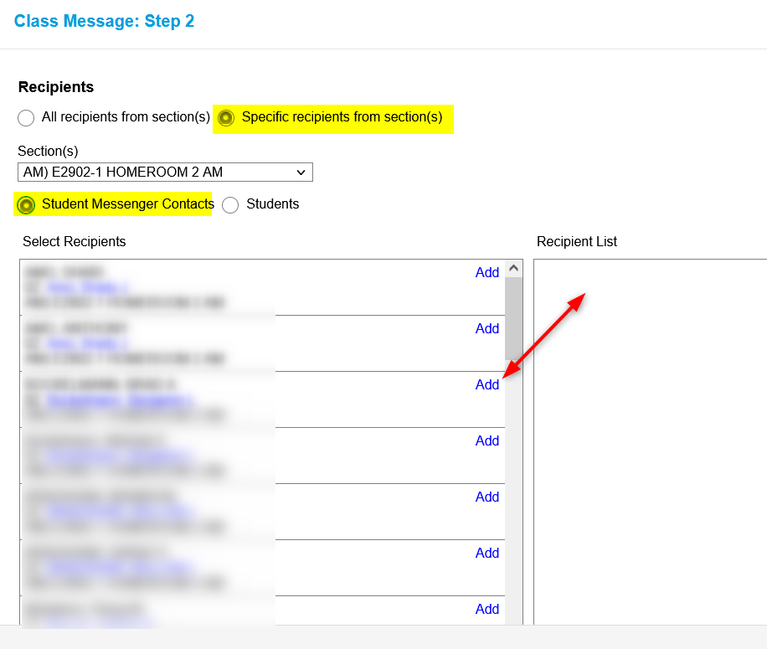
Message Center – Email to Specific People
Click on Specific recipients from section(s)
Choose the student’s contacts (parents)
Click Add for the ones you want to email
Contacts will show in the Recipient Column
Click NEXT

Slide 26
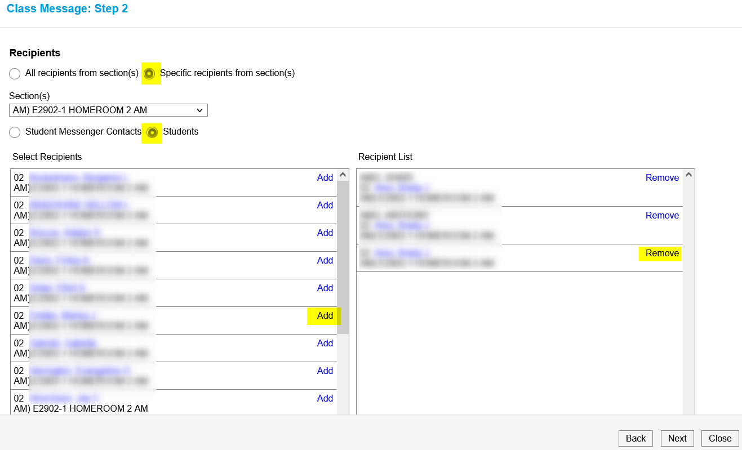
Message Center - Email to Specific People
Click on Students
Click Add for specific students
Contacts will show in the Recipient Column
If you need to remove one, click remove
Click NEXT

Slide 27
Message Center – Email
Here is the message being sent and to whom it is sent.
You can review the recipients in detail by clicking the Review Recipients button.
Click SEND

Slide 28
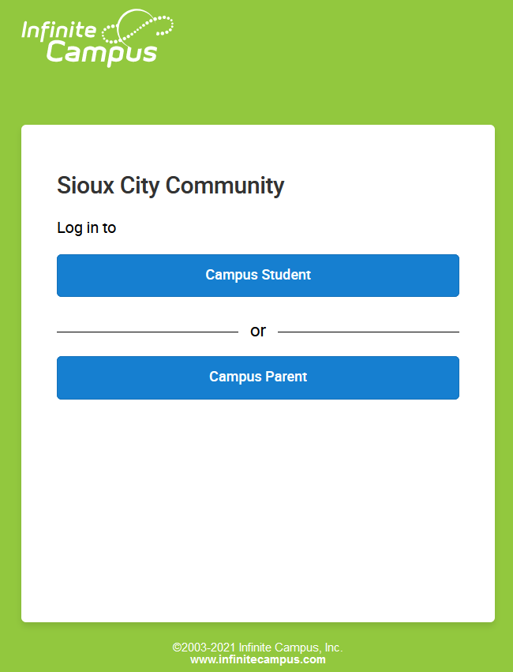
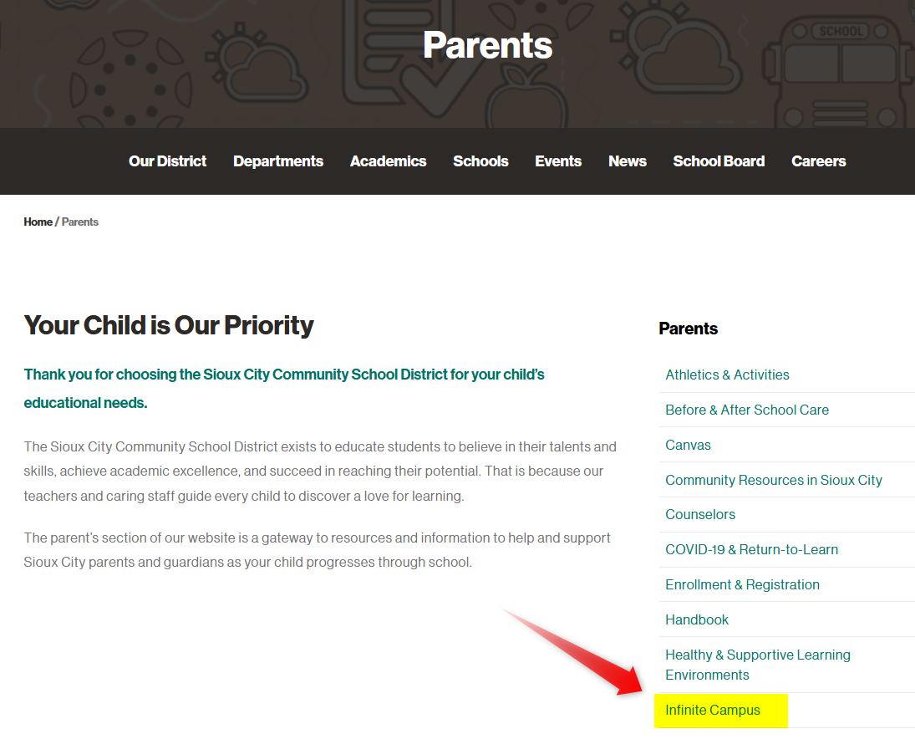
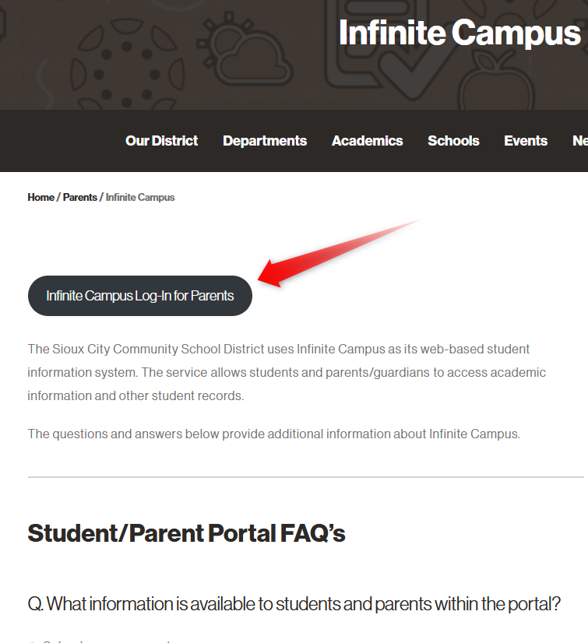
Parent/Student Portals

Slide 29
Parent/Student Portals

Slide 30
Reports for Teachers

Slide 31
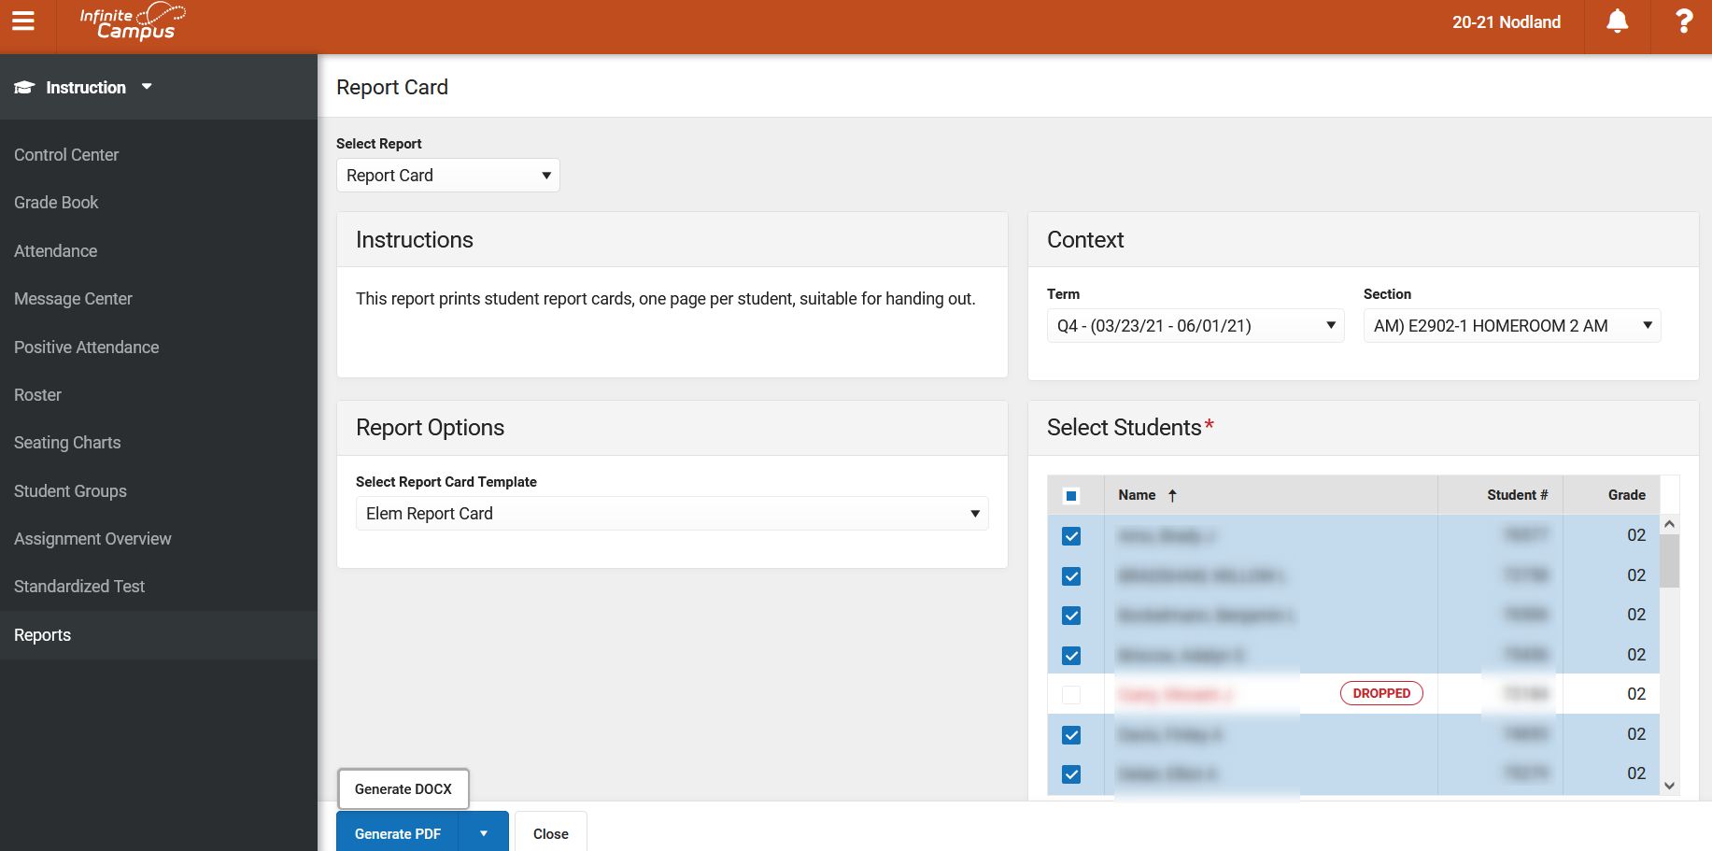
Reports – Report Cards

Slide 32
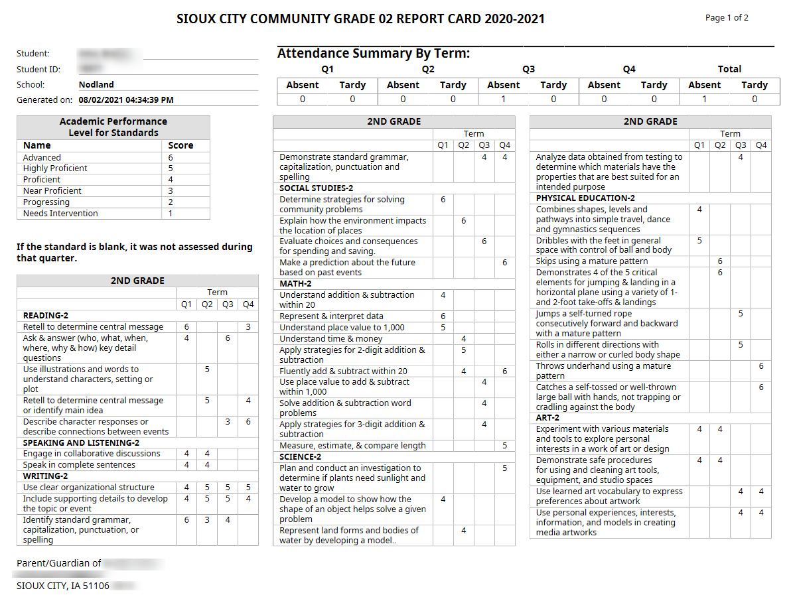
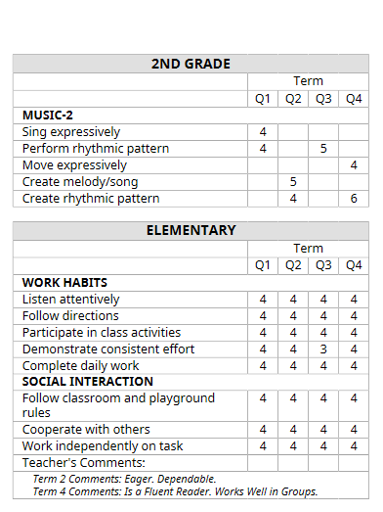
Sample Report Card – Page 1 and 2

Slide 33
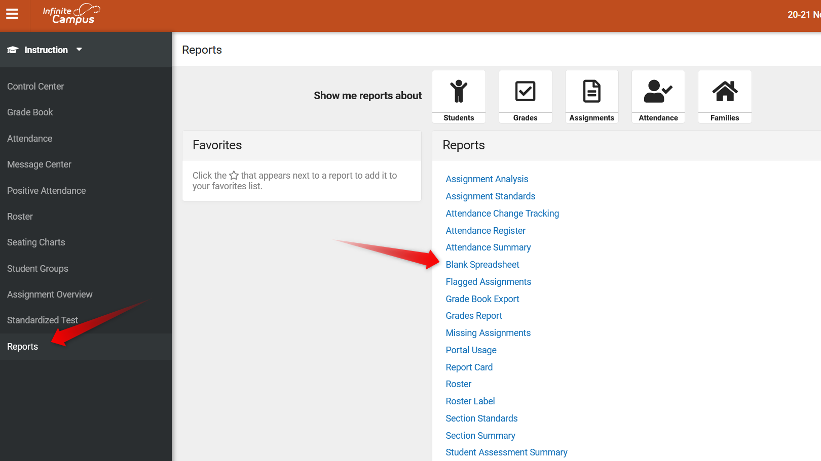
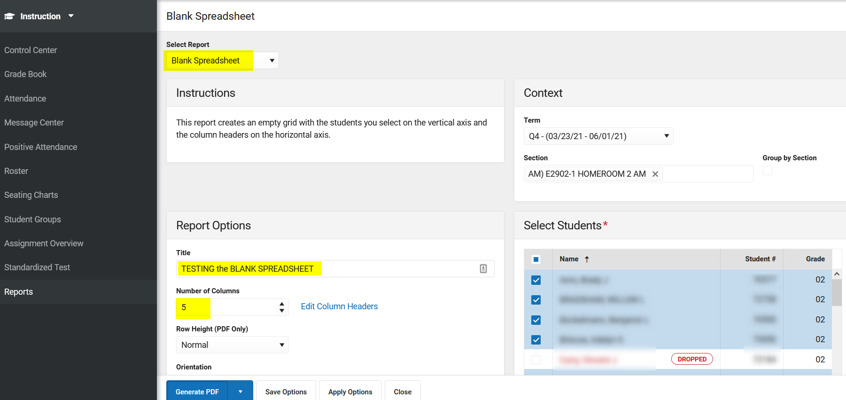
Reports – Blank Spreadsheet

Slide 34
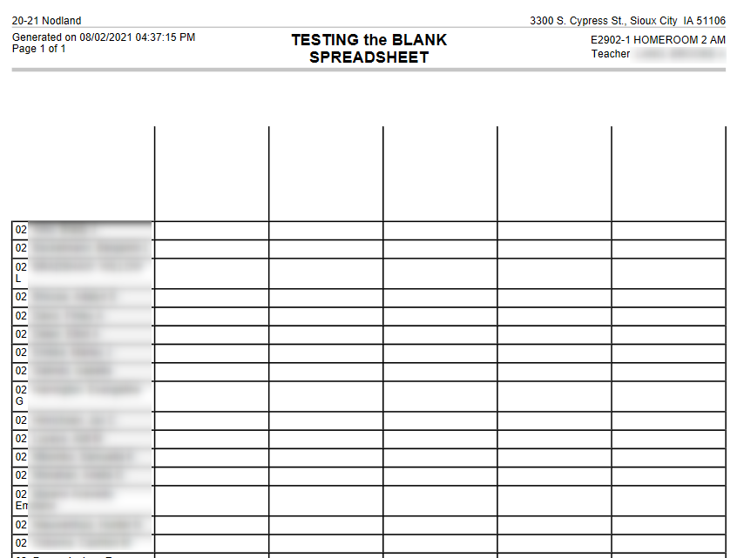
Reports – Blank Spreadsheet

Slide 35
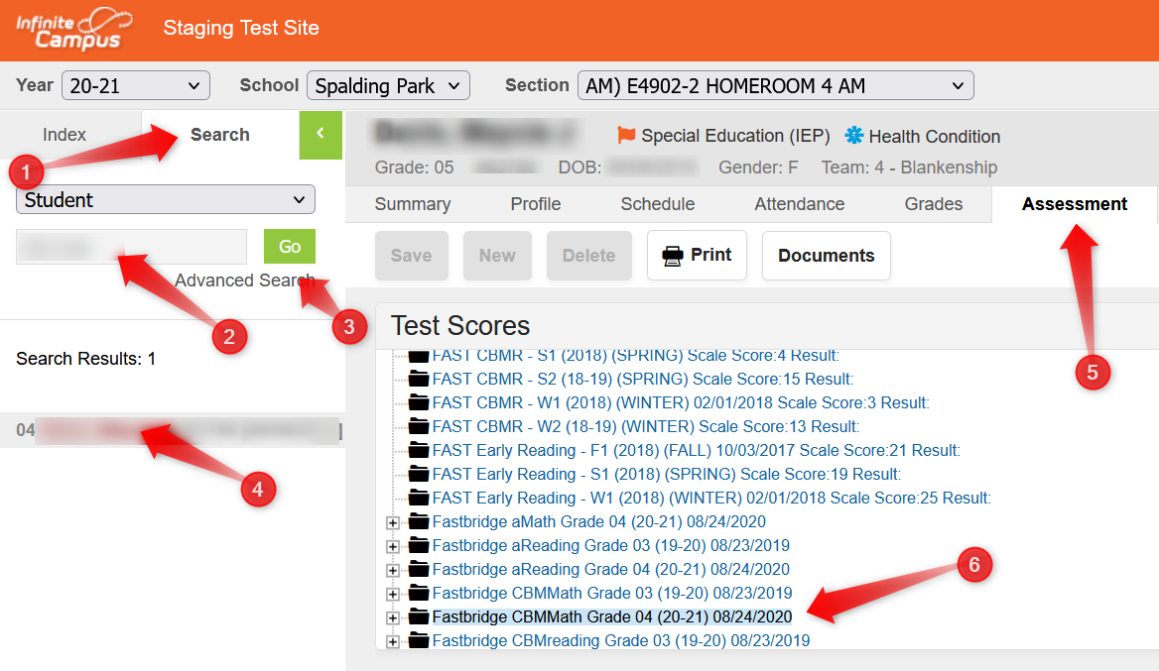
Assessments Tab in IC

Slide 37
Clever with Ashley Wheat

